Slide 1
Databases Design. Introduction to SQL LECTURE 6 SQL. Data Manipulation Language
IITU, ALMATY, 2020

Slide 2
SQL
SQL (Structured Query Language) is a special-purpose programming language designed for managing data held in a relational database management system (RDBMS).
SQL keywords are NOT case sensitive: select is the same as SELECT
All SQL queries must end with a semicolon “;”
Semicolon is the standard way to separate each SQL statement in DBMS that allow more than one SQL statement to be executed in the same call.

Slide 3
SQL Comments
Comments are used to explain sections of SQL statements, or to prevent execution of SQL statements.
Single line comments start with --.
Any text between -- and the end of the line will be ignored (will not be executed).
--Select all: SELECT * FROM Students;

Slide 4
SQL Comments
Multi-line comments start with /* and end with */.
Any text between /* and */ will be ignored.
/*Select all the columns of all the records in the Students table:*/ SELECT * FROM Students;
To ignore just a part of a statement, also use the /* */ comment.
SELECT lname, /*fname,*/ gpa
FROM Students;

Slide 5
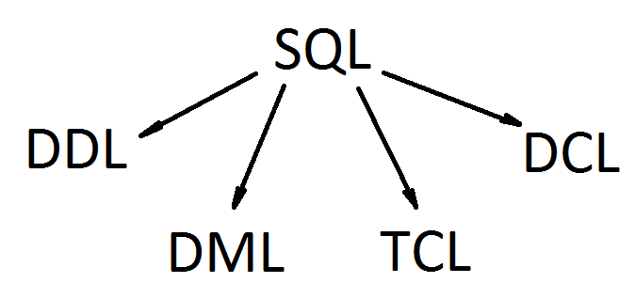
SQL Structure
DDL (Data Definition Language)
DML (Data Manipulation Language)
TCL (Transaction Control Language)
DCL (Data Control Language)

Slide 6
Last lecture
Data Definition Language (DDL) defines constructs that structure the data in the database.
DDL statements:
CREATE DB
CREATE TABLE
ALTER TABLE
DROP TABLE

Slide 7
Data Manipulation Language
Data Manipulation Language (DML) is a sublanguage of SQL and it's used for selecting, inserting, deleting and updating data in a database.
DML statements:
INSERT
UPDATE
DELETE
SELECT

Slide 8
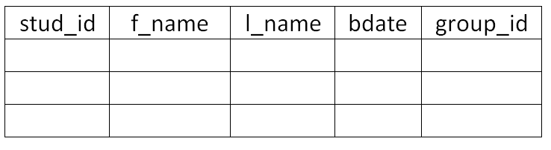
DDL vs. DML
When a table is created (with DDL statements), it contains no data (data - DML).

Slide 9
INSERT
INSERT statement is used to insert new records in a table.
Syntax:
INSERT INTO table_name VALUES (values);
In SQL all strings and dates must be single-quoted.
The data values are listed in the order in which the columns appear in the table, separated by commas.

Slide 10
INSERT: example 1
To insert a record in the Students table, we write:
INSERT INTO Students
VALUES (1, ‘Firstname1’, ‘LastName1’, ’31.12.1994’,1);
So, we would be incorrect in writing:
INSERT INTO Students
VALUES (‘Firstname1’, ‘LastName1’, 1, ’31.12.1994’, 1);

Slide 11
INSERT: example 2
It’s possible to insert a subset of the data in a table. We can tell which columns we would like to insert:
INSERT INTO table_name (column(s))
VALUES (values);
Insert a new record into the Students table for a student with id=2 and no birthdate:
INSERT INTO Students (stud_id, f_name,
l_name, group_id)
VALUES (2, ‘Firstname2’, ‘Lastname2’, 1);

Slide 12
INSERT: example 3
Data is conceptually inserted one row at a time. However you can insert multiple rows in a single command:
INSERT INTO Students (stud_id, f_name, l_name, group_id)
VALUES (1, ‘FirstName1’, ‘LastName1’, 1),
(2, ‘FirstName2’, ‘LastName2’, 1);

Slide 13
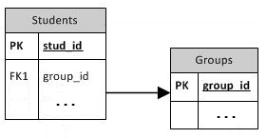
Referential Integrity (CREATE TABLE)
Condition for using referential integrity:
The table that the FK references must have been created before the foreign keys are defined
Ex., the Groups table must be created first, and then the Students table (with its FK) may be created.

Slide 14
Referential Integrity (CREATE TABLE)
CREATE TABLE Groups(
group_id int,
group_name varchar(15),
PRIMARY KEY (group_id));
CREATE TABLE Students(
stud_id int,
first_name varchar(20),
last_name varchar(20),
bdate date,
group_id int,
PRIMARY KEY (stud_id),
FOREIGN KEY (group_id) REFERENCES Groups(group_id));

Slide 15
Referential Integrity (INSERT)
Rows can’t be inserted in the Students table without a matching rows in the Groups table. This record is unavailable while the Groups table is empty:
INSERT INTO Students
VALUES (1, ‘FirstName1’, ‘LastName1’,’31.12.1994’,1);
ERROR: insert or update on table “students" violates foreign key constraint “students_group_id_fkey"
DETAIL: Key (group_id)=(1) is not present in table “groups".

Slide 16
UPDATE
SQL provides the UPDATE statement to change values in tables.
Syntax:
UPDATE table_name
SET column = value [, column = value, …]
[WHERE condition] ;
The condition in the WHERE portion of the UPDATE statement is known as a selection condition.
A selection condition is similar to if-statements in a traditional programming language.

Slide 17
UPDATE: example 1
Suppose we have a student with stud_id=2 and group_id=1 that needs to be updated to group_id=2.
We would write this as
UPDATE Students
SET group_id=2
WHERE stud_id=2;

Slide 18
UPDATE: examples 2, 3
The SQL command to change the name of the student with stud_id=1 to Aigul:
UPDATE Students
SET f_name=‘Aigul’
WHERE stud_id=1;
The SQL command to change the birthdate of the student with stud_id=2 to 15.10.1994:
UPDATE Students
SET bdate=’15.10.1994’
WHERE stud_id=2;

Slide 19
UPDATE: example 4
Each column can be updated separately; the other columns are not affected.
You can update individual rows, all the rows in a table, or a subset of all rows.
For example, this command updates all students that have group_id=1 to have group_id=2:
UPDATE Students
SET group_id=2
WHERE group_id=1;

Slide 20
UPDATE: example 5
The expression for the new value can refer to the existing value(s) in the row.
If you want to raise the price of all products by 10% you could use:
UPDATE Products SET price = price*1.10;
We also left out the WHERE clause. If it is omitted, it means that all rows in the table are updated. If it is present, only those rows that match the WHERE condition are updated.

Slide 21
DELETE: example 1
SQL provides the DELETE statement to delete data from tables.
Syntax:
DELETE FROM table_name
[WHERE condition];

Slide 22
DELETE: example 2
To delete all rows in the Students table:
DELETE FROM Students;
To delete the student with stud_id=2:
DELETE FROM Students
WHERE stud_id=2;

Slide 23
DELETE: example 3
To remove all rows from the Products table that have a price of 10:
DELETE FROM Products
WHERE price=10;

Slide 24
Next lecture: SELECT
SQL allows to query data with SELECT statement.
Syntax:
SELECT attribute(s)
FROM table(s);

Slide 25
Books
Connolly, Thomas M. Database Systems: A Practical Approach to Design, Implementation, and Management / Thomas M. Connolly, Carolyn E. Begg.- United States of America: Pearson Education
Garcia-Molina, H. Database system: The Complete Book / Hector Garcia-Molina.- United States of America: Pearson Prentice Hall
Sharma, N. Database Fundamentals: A book for the community by the community / Neeraj Sharma, Liviu Perniu.- Canada
www.postgresql.org/docs/manuals/

Slide 26
Question
Third normal form is based on the concept of …
Transitive dependency
Partial dependency
Foreign dependency
None of the given

Slide 27
Question
A table in 1NF in which the Primary key consists of two of its three attributes:
Always violates 2NF
Never violates 2NF
May violate 2NF
None

Slide 28
Question
A table has fields F1, F2, F3, F4 and F5 with the following functional dependencies:
F1 -> F3,
F2 -> F4,
(F1, F2) -> F5.
In terms of normalization, this table is in …
1NF
2NF
3NF
UNF

